Slide 1
Amortized Analysis
Operation P is called n times.
Each call to P is not independent: its execution time depends on the previous calls.
The “average” cost to P considers the average over successive calls.
  Compared to the “average-case” analysis which considers the average over all instances based on their distribution
for (i=0; i<n; i++) P;
or
…P1…P2….Pi………Pn…

Slide 2
Example: memory allocation
Memory allocation in garbage collection-based programming languages such as java, .net
  An allocation is fast when there is space available
  It triggers garbage collection when no enough space left to satisfy the request

Slide 3
Example: binary counter
void IncrementCounter(Bit A[], int k) // k = length(A)
{
int i = 0;
while (i<k && A[i] == 1) {
A[i] = 0;
i++;
}
if (i < k)
A[i] = 1;
}
Each call increases the counter by 1 until the counter rolls back to 0

Slide 4
Example: binary counter
void IncrementCounter(Bit A[], int k) // k = length(A)
{
int i = 0;
while (i<k && A[i] == 1) {
A[i] = 0;
i++;
}
if (i < k)
A[i] = 1;
}
We count #flips
for total cost
Worst case the loop executes k times and takes time Ө(k).
It takes time O(nk) for n calls

Slide 5
Experimental results
k (#bits) | Total iterations | Average iterations
1 | 2 | 1.0
2 | 6 | 1.5
4 | 30 | 1.875
8 | 510 | 1.9922
16 | 131070 | 2.0000

Slide 6
Three analyzing methods
Aggregate analysis
The accounting method
The potential method

Slide 7


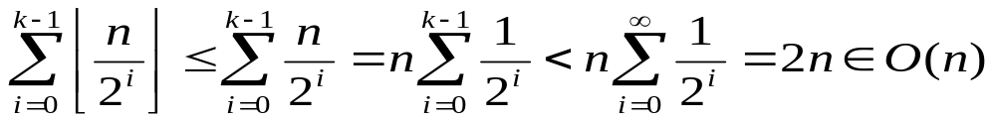
An aggregate analysis: binary counter
For n consecutive operations
  A[0] flips each time incrementCounter() is called
  A[1] flips times
  …
  A[i] flips times
  …
Total flips is
Average flips per operation ≈ 2

Slide 8
Stack operations
Three operations
  PUSH(S, x): pushes object x onto stack S. Cost O(1).
  POP(S): pops the top of stack and return the popped object. Cost O(1).
  MULTIPOP(S, k): pops the top k objects or the entire stack if it contains less than k objects. Cost O(min(s, k)) where s is the size of the stack.
MULTIPOP(S, k)
{
while (!empty(S) and k > 0) {
POP(S);
k--;
}
}

Slide 9
Amortized analysis for Stack
What is the worst case cost of n stack operations on an initially empty stack
  One MULTIPOP takes O(n)
  n operations take O(n²)
  Average is O(n)
An aggregate analysis
  Observation:
    the total numbers of PUSH(), P <= n
    The total number of POP() called including those in MULTIPOP <= P <=n
  The total cost is O(n)
  And the average is O(1)
This is not tight!

Slide 10
The accounting method
Set up a virtual bank with the initial balance 0
“Guess” an upper bound of the amortized cost of each call/operation. Let it be τ.
  Deposit the amortized cost, τ, dollars for each operation
    τ can be associated with a specific object
  Draw the actual cost, c, dollars of each operation from the bank
    If c < τ, you get extra credits that can be associated with specific objects
    If c > τ, you spend your savings
Show that the bank is never overdrawn

Slide 11
Accounting for binary counter
Assume amortized cost: 2
  Allocate 2 dollars for each call
  Associate the 2 dollars with the bit set
Actual cost:
  Spend one dollar when a bit is flipped (set or reset)
Analysis
  Each bit “1” gets 1 dollar credit associated with it
  Pay the flipping cost of each bit using the credit
  Balance = the number of 1’s which is never negative

Slide 12
Accounting for Stack
Assume amortized cost:
  PUSH: 2
  POP: 0
  MULTIPOP: 0
Actual cost:
  PUSH(S, x): 1
  POP(S): 1
  MULTIPOP(S, k): min(s, k)
Show the bank is never overdrawn
  When an object is pushed, it gets 1 dollar credit (deposit 2, pay 1)
  When an object is popped, pay using its credit.
  The bank balance = # objects in the stack

Slide 13





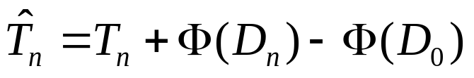

Potential functions
A potential function describes the state of “cleanliness” before a process/operation executes.
  A large value of the state means “dirtier”: it denotes the amortized cost of the following processes
  Let be the value of the initial state and be that of the state after the i^{th} call, the amortized time taken by the i-th call is
  Let denote the total time required for the n calls, and be the total amortized time, we have
  can be an upper bound for when

Slide 14
Potential method for Binary Counter
We use the number of ones as potential function
Then the amortized cost of adding one to the counter is
  The counter value is even. The least significant bit (A[0]) is set and it adds one more 1. The amortized cost is 1+1=2.
  All bits of the counter is 1. The loop executes k times and all k 1s change to 0s. The amortized cost is k+(0-k) = 0.
  In other cases, assume the loop executes i times. It flips each of the rightmost i bits from 1 to 0, and set (i+1)-th bit from 0 to 1. The 1s decreases by i-1. The amortized cost if (i+1)-(i-1) = 2.

Slide 15




Potential Method for Stack
Let
Actual cost:
  PUSH(S, x): 1
  POP(S): 1
  MULTIPOP(S, k): k’= min(s, k)
Amortized cost:
  PUSH:
  POP:
  MULTIPOP:

